Slide 1
Operating Systems in IoT

Slide 2
INTERNET OF THINGS (IOT)
Internet Connected Objects like RFIDs, Sensors, Actuators, Instruments and smart appliances.
Context aware communication and computing
Mainly works with IPv6 rather than IPv4
Powered mainly by Sensor Nodes which are low cost, small size and power efficient
Real Time Guarantee

Slide 3
OS DESIGN FOR CONSTRAINED DEVICES
Structure of the Kernel
Monolithic
lacks modularity and becomes complex once the size exceeds a limit
Layered Approach
one has to segregate between the kernel mode and user mode
Micro Kernel
This method is preferred as only limited set of tools runs under Kernel Mode and most other drivers and modules runs under User mode which very easy to handle and kernel will not be overloaded.
Programming Model
No memory segmentation
Every process run in its own thread and has its own memory stack

Slide 4
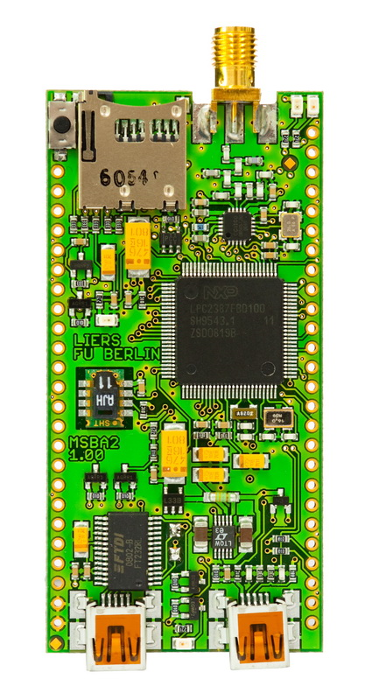
Challenges in the IoT
Heterogeneous hardware
Ranging from 8bit microcontrollers to quite powerful smartphones or routers
Various communication interfaces (mostly, but not limited to wireless networks)
Slow CPU, often no FPU
Little memory, often no MMU
Limited energy resources
Robustness and self-organization
Real-Time requirements

Slide 5
OPERATING SYSTEMS
TinyOS (No support available as on date, no support for latest IOT devices)
Contiki OS (So Popular)
RIOT OS (Upcoming)
Free RTOS (Just 4 or 5 files that makes the entire OS, but limited functionality)

Slide 6
IoT OS
Tiny OS
Monolithic kernel
Contiki OS
Layered architecture
RIOT OS
Micro kernel
Uses nesc (network embedded system c compiler)
Algorithms
Protocols
Shell
Devices drivers
Not actively maintained
C & C++ support
Proto threads
Micro IP Stack
Device drivers
Communication API
Run time code replacement
Tickless scheduler
Low clock speed
C,C++,POSIX(Windows,Linux,Unix family,Solaris,Mac)
Supports RPL,6LoWPAN,IPv6,TCp,UDP

Slide 7
Comparision
 | Tiny OS | Contiki | RIOT
RAM | <1 kb | <2 kb | ~1.5kb
ROM | <4 kb | < 30 kb | < 5 kb
multithreading | No | NO (Proto threads) | yes
Modularity | NO | partial | yes
Programming language | Nesc | C,C++ Partially | C,C++

Slide 8
References
https://devopedia.org/iot-operating-systems

